Slide 1








TELANGANA GROWTH ANALYSIS
Telangana is one of the fastest-growing states in India and one of the states with an open data policy.

Slide 2
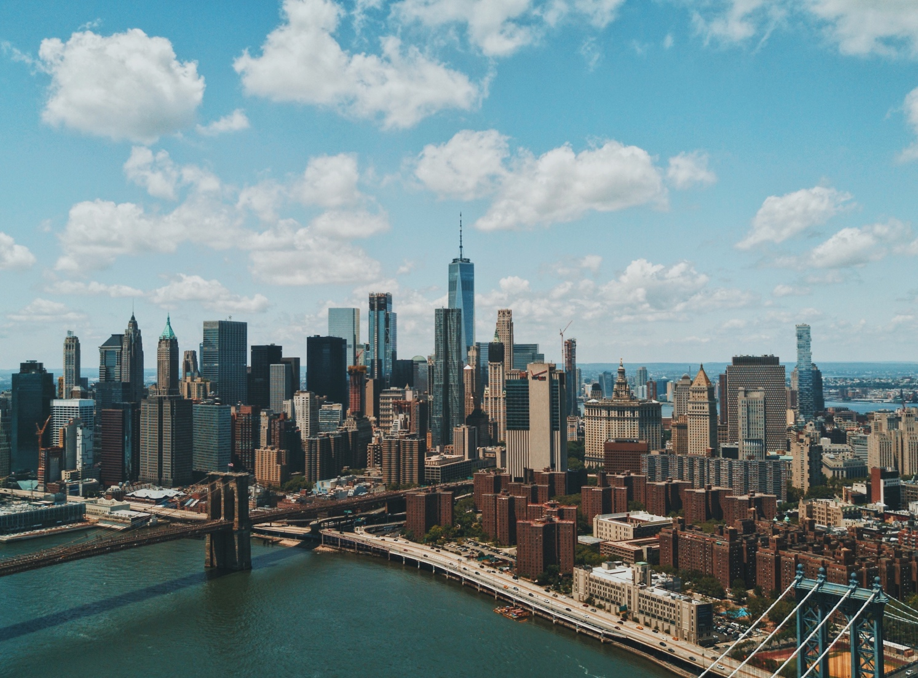
Objective:
Explore Stamp Registration, Transportation and Ts-Ipass Datasets.
Understand their attributes, categories and time period.
Analyse trends and patterns within each department.
Identify growth opportunities and areas needing attention.
Find correlation among these departments and report the overall growth of the state through insights and relevant visuals such as shape maps.

Slide 3
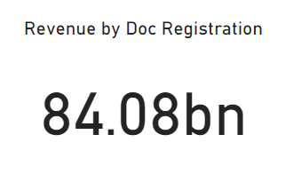
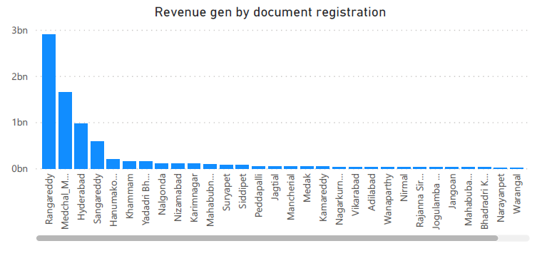
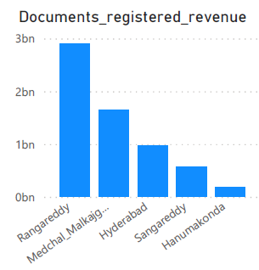
top 5 district
Q-01 "DISTRICT-WISE DOCUMENT REGISTRATION REVENUE TRENDS IN TELANGANA (FY 2019 - 2022)"
There are 33 districts in Telangana state but, we can clearly see that only 9 districts are generating more than 100 million revenue from the registered documents.
Rangareddy
Medchal Malkajgiri
Hyderabad
Sangareddy
Hanumakonda

Slide 4
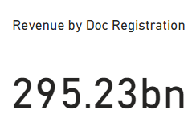
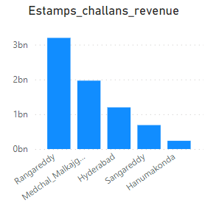
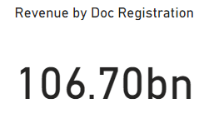
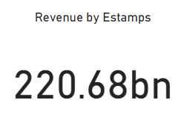
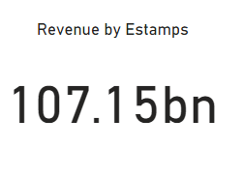
top 5 district where e-stamp revenue is higher form doc. Registration rev.
Q-02"COMPARING DOCUMENT REGISTRATION REVENUE TO E-STAMP CHALLANS REVENUE ACROSS DISTRICTS IN FY 2022"
Rangareddy
Medchal Malkajgiri
Hyderabad
Sangareddy
Hanumakonda
Total Revenue generated by documents registration is 33.83% higher than the revenue generated by E-stamp challans across the district of Telangana. The reason behind this can be taken as that the E-stamp challan duty started in the month December of year 2020. Now if we see in the FY 2022, 0.42% of the revenue generated by E-stamp Challan across the districts of Telangana is comparatively higher than the revenue regenerated by the document registration.
Total Revenue Generated in FY 2019-2023
Total Revenue Generated in FY 2022

Slide 5
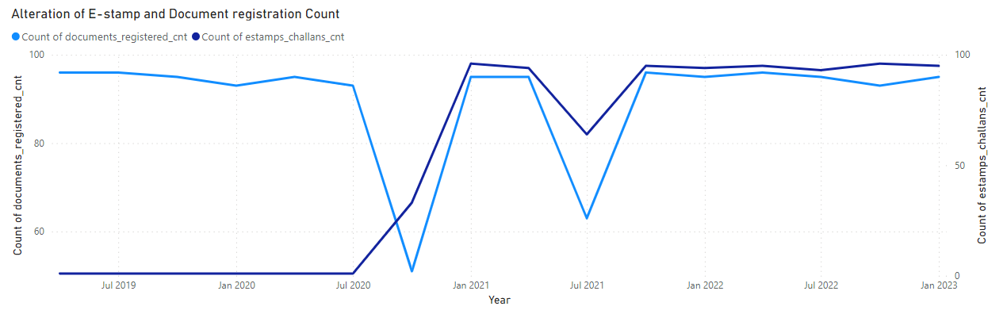
Q-03"ASSESSING CHANGES IN E-STAMP CHALLAN AND DOCUMENT REGISTRATION PATTERNS POST-IMPLEMENTATION: RECOMMENDATIONS FOR GOVERNMENT"
RECOMMENDATIONS:
By focusing on awareness, support, and infrastructure improvements, the government can continue to foster the adoption of e-Stamp challans and ensure a seamless experience for all stakeholders.
There has been a noticeable alteration in the pattern of e-Stamp challan count and document registration count. This change is clearly reflected in the line chart that represents the trend of these counts on a quarterly basis from 2019 to 2023.
The shift in the pattern of e-Stamp challan count and document registration count indicates a successful transition towards a more digital and efficient method of payment and registration.

Slide 6
top 3 district with high revenue
Q-04"CATEGORIZING DISTRICTS BY STAMP REGISTRATION REVENUE GENERATION (FY 2021-2022)"
top 3 district with medium revenue
top 3 district with low revenue
MORE THEN 1 BILLION INR
BETWEEN 300 MILLION - 1 BILLION INR
LESS THEN 300 MILLION INR
TOTAL 10 DISTRICT
TOTAL 12 DISTRICT
TOTAL 10 DISTRICT
Rangareddy
Medchal Malkajgiri
Hyderabad
Mahabubnagar
Suryapet
Siddipet
Rajanna Sircilla
Nirmal
Jogulamba Gadwal
These are districts with exceptional revenue performance during the specified fiscal year.
These are districts with steady revenue performance during the specified fiscal year.
These are districts that may require attention and strategies for revenue enhancement.

Slide 7
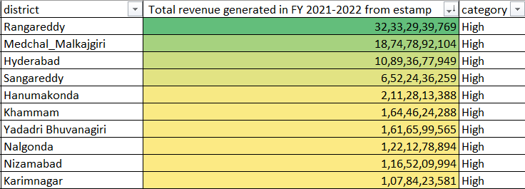
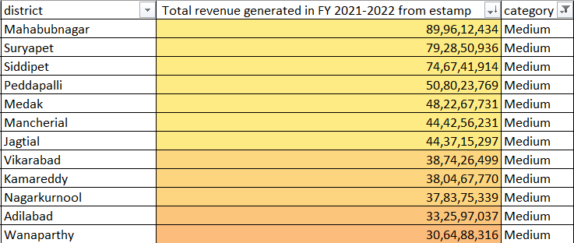
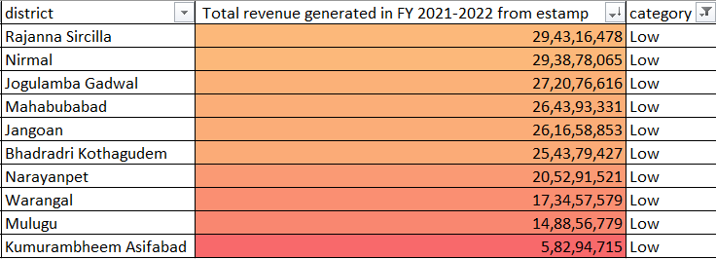
LIST OF district with high revenue
LIST OF district with medium revenue
LIST OF district with low revenue

Slide 8
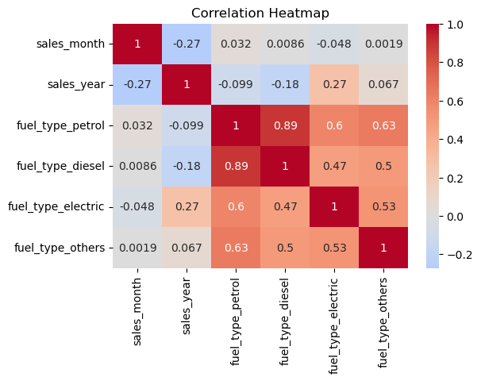
Q-05"EXPLORING SEASONAL PATTERNS IN VEHICLE SALES:
FUEL-TYPE ANALYSIS"
sales_month vs. fuel_type_petrol: The correlation coefficient is 0.032, which is quite low. This suggests a very weak positive correlation between the month and the sales of vehicles with petrol fuel type. This indicates that there might not be a strong month-specific pattern for petrol vehicle sales.
sales_month vs. fuel_type_diesel: The correlation coefficient is 0.009, which is again very low. Similar to petrol, there seems to be a weak positive correlation between the month and the sales of vehicles with diesel fuel type.
sales_month vs. fuel_type_electric: The correlation coefficient is -0.048, which is close to zero. This indicates a very weak negative correlation between the month and the sales of electric vehicles. This suggests that there might not be a consistent pattern for electric vehicle sales across months.
sales_month vs. fuel_type_others: The correlation coefficient is 0.002, which is very close to zero. This suggests almost no correlation between the month and the sales of vehicles with other fuel types.
Overall, based on the correlation values, it seems that there isn't a strong correlation between specific months and the sales of vehicles based on fuel type. This indicates that the month or season might not be a major driving factor affecting vehicle sales in different districts.

Slide 9
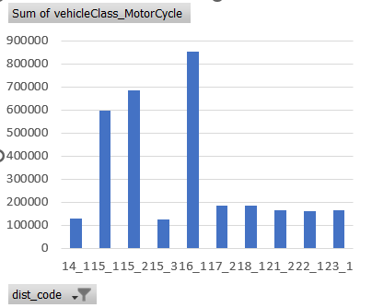
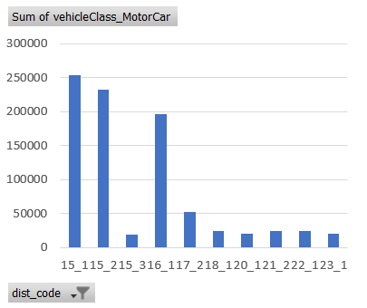
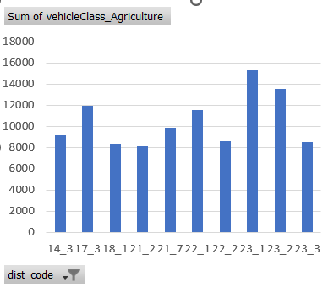
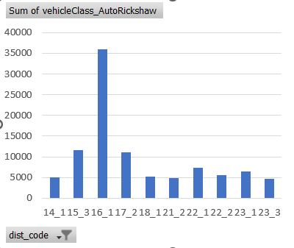
Q-06"DISTRICT-WISE DISTRIBUTION OF VEHICLE CLASSES IN FY 2022"
Distinct District Preferences:
Some districts have a predominant preference for specific vehicle classes.
Districts such as Hyderabad, Medchal Malkajgiri and Rangareddy show a significant preference for Motorcycles.
In contrast, other districts like Rangareddy prioritize Motorcars followed by Medchal Malkajgiri and Hyderabad.
Highest agricultural vehicle sold mainly in two districts Siddipet and Nalgonda
Variation in Vehicle Classes:
The distribution of vehicles varies across districts for different classes.
Each district showcases its own preferences in terms of vehicle classes.
Diverse Vehicle Mix:
Certain districts exhibit a balanced distribution across multiple classes.
This diversity reflects the region's economic and transportation dynamics.
Hyderabad
Medchal_Malkajgiri
Rangareddy
Sangareddy
Nizamabad
Rangareddy
Medchal_Malkajgiri
Hyderabad
Sangareddy
Nizamabad
Nalgonda
Suryapet
Siddipet
Khammam
Jayashankar Bhupalpally
Hyderabad
Vikarabad
Sangareddy
Khammam
Nalgonda

Slide 10
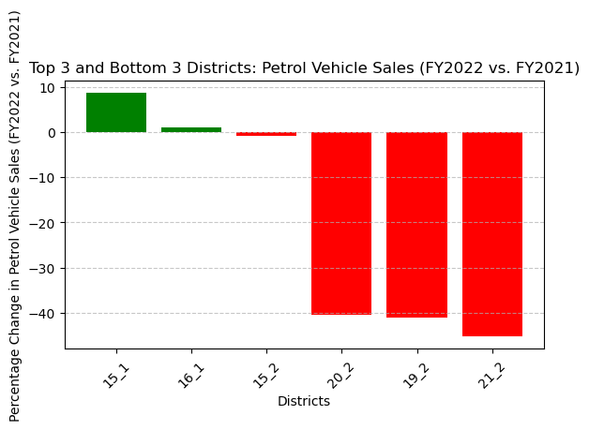
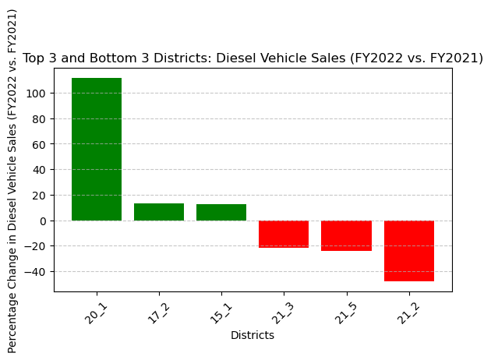
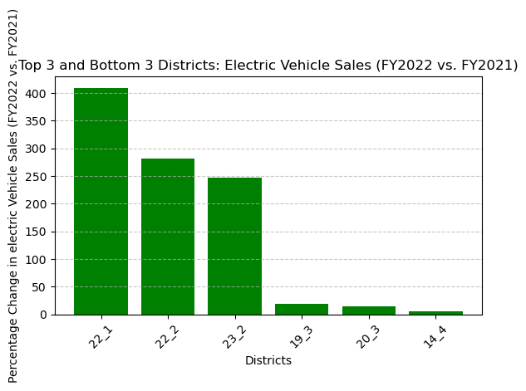
Q-07 "TOP AND BOTTOM DISTRICTS BY VEHICLE SALES GROWTH (FY 2022 VS. FY 2021)"
Petrol Vehicle Sales Growth:
Top 3 Districts with the Highest Petrol Vehicle Sales Growth (FY2022 vs. FY2021):
Rangareddy - 8.73% growth
Hyderabad - 1.03% growth
Medchal_Malkajgiri - 0.90% change
Bottom 3 Districts with the Lowest Petrol Vehicle Sales Growth (FY2022 vs. FY2021):
Jagtial - 40.53% decline
Nirmal- -41.05% decline
Warangal- -45.32% decline
Diesel Vehicle Sales Growth:
Top 3 Districts with the Highest Diesel Vehicle Sales Growth (FY2022 vs. FY2021):
Karimnagar - 111.44% growth
Sangareddy - 13.21% growth
Rangareddy - 12.67% growth
Bottom 3 Districts with the Lowest Diesel Vehicle Sales Growth (FY2022 vs. FY2021):
Jangoan - -21.99% decline
Mahabubabad - -24.29% decline
Warangal- -48.03% decline
Electric Vehicle Sales Growth:
Top 3 Districts with the Highest Electric Vehicle Sales Growth (FY2022 vs. FY2021):
Khammam - 409.40% growth
Bhadradri Kothagudem - 281.58% growth
Suryapet - 247.15% growth
Bottom 3 Districts with the Lowest Electric Vehicle Sales Growth (FY2022 vs. FY2021):
Mancherial - 19.19% growth
Rajanna Sircilla - 14.92% growth
Wanaparthy - 5.48% growth

Slide 11
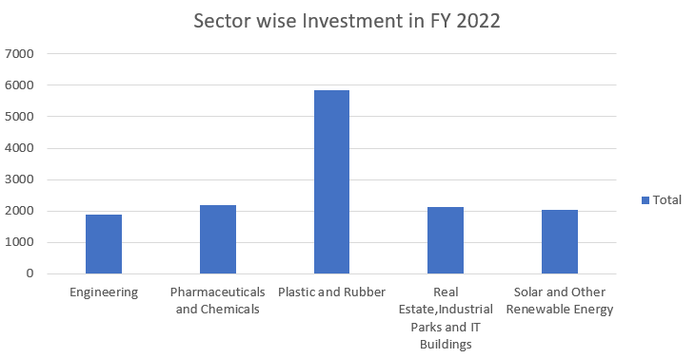
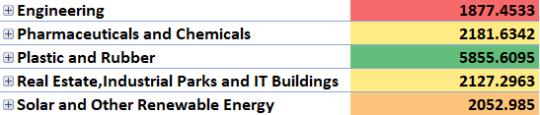
Q-08 "TOP 5 SECTORS WITH THE HIGHEST INVESTMENTS IN FY 2022"
LIST OF TOP 5 SECTORS
Plastic and Rubber
Pharmaceuticals and Chemicals
Real Estate, Industrial Parks and IT Buildings
Solar and Other Renewable Energy
Engineering
These sectors have demonstrated their potential to contribute to economic advancement, employment generation, and overall industrial progress. The substantial investments in these sectors underscore Telangana's commitment to fostering diverse and sustainable growth avenues.

Slide 12
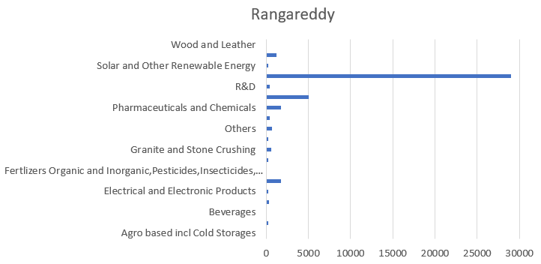
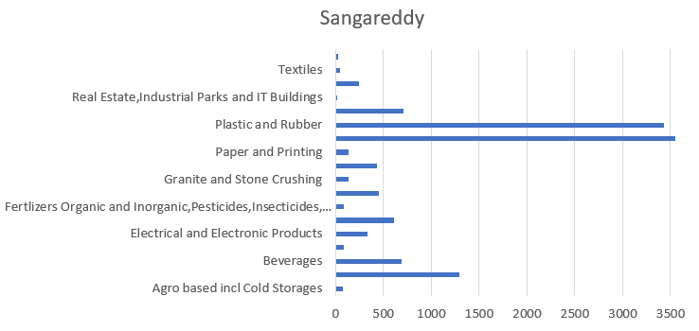
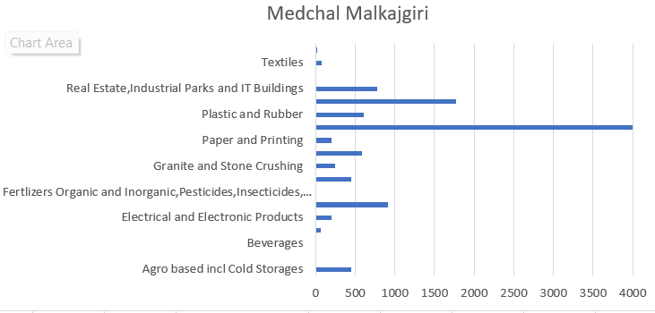
Q-09 "UNLOCKING INVESTMENT INSIGHTS: TOP 3 DISTRICTS WITH SIGNIFICANT SECTOR INVESTMENTS (FY 2019-2022)"
Rangareddy:
Rangareddy district secured the top spot with the highest investments, led by the "Real Estate, Industrial Parks, and Buildings" sector. This district's appeal lies in its strategic location, infrastructure, and growing urban landscape.
Sangareddy:
Sangareddy district secured the second position, driven by two significant sectors - "Pharmaceuticals & Chemicals" and "Plastic & Rubber." Its success can be attributed to its focus on pharmaceutical manufacturing and its growing contribution to the plastics and rubber industry.
Medchal Malkajgiri:
Medchal Malkajgiri district clinched the third position with a primary focus on the "Pharmaceuticals & Chemicals" sector. Its noteworthy investments reflect the district's emphasis on driving advancements in pharmaceutical and chemical manufacturing.

Slide 13
Factors Contributing to Investment Success:
Strategic Sector Focus:
Each district capitalized on sectors where it possessed inherent strengths, creating an investment-friendly environment.
Infrastructure and Connectivity:
Robust infrastructure, coupled with well-connected transportation networks, boosted these districts' attractiveness to investors.
Diversified Economy:
Diversification into multiple sectors allowed these districts to mitigate risks and attract a broader range of investors.
Government Support:
Supportive policies and initiatives encouraged investments, promoting ease of doing business and reducing bureaucratic hurdles.
Skilled Workforce:
A skilled labour pool equipped with sector-specific expertise enhanced these districts' capabilities, attracting investor confidence.

Slide 14
Q-10"EXPLORING INTERCONNECTIONS: DISTRICT INVESTMENTS, VEHICLE SALES, AND STAMPS REVENUE (FY 2021-2022)"
Investment vs. Revenue:
Investment in crores (CR) shows a weak positive correlation with:
Documents Registered Revenue (0.1035)
e-Stamps Challans Revenue (0.1075)
These relationships indicate that as investments increase slightly, both document registration and e-stamps revenue tend to increase.
Investment vs. Vehicle Sales:
Investment in CR exhibits weak positive correlations with various vehicle sales categories:
Petrol Vehicle Sales (0.1122)
Diesel Vehicle Sales (0.1144)
Electric Vehicle Sales (0.1111)
These correlations suggest that higher investments are associated with slightly increased sales of vehicles with different fuel types.
Investment vs. Vehicle Class:
Investment in CR shows weak positive correlations with different vehicle classes:
Motorcycles (0.1132)
Motorcars (0.1109)
Others (0.1099)
These correlations imply that as investments rise, sales of motorcycles, motorcars, and other vehicle classes tend to increase slightly.
Investment vs. Seating Capacity and Sales Categories:
Investment in CR also exhibits weak positive correlations with:
Vehicle seating capacity categories
Vehicle sales categories
These relationships indicate that increased investments are linked to slightly higher sales of vehicles with different seating capacities and in various sales categories.
Revenue vs. Vehicle Sales:
Both Documents Registered Revenue and e-Stamps Challans Revenue demonstrate strong positive correlations with Petrol Vehicle Sales, Diesel Vehicle Sales, and Electric Vehicle Sales.
This suggests that higher revenue from document registration and e-stamps is associated with increased sales of vehicles using these fuel types.
Fuel Type vs. Vehicle Class:
Fuel type variables (Petrol, Diesel, Electric) display strong positive correlations with various vehicle classes (Motorcycles, Motorcars, Others).
This indicates that certain fuel types are linked to increased sales in specific vehicle classes.

Slide 15
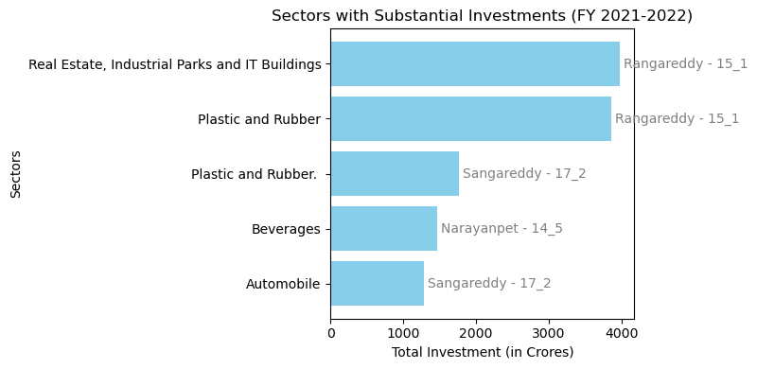
Q-11 "ANALYSIS OF SECTOR-WISE INVESTMENTS ACROSS DISTRICTS IN FY 2021 AND 2022"
Sectors with Substantial Investments Across Multiple Districts (FY 2021-2022):
Real Estate, Industrial Parks and IT Buildings (District: Rangareddy )
Total Investment: ₹3,979.80 Crores
Plastic and Rubber (District: Rangareddy)
Total Investment: ₹3,866.41 Crores
Plastic and Rubber (District: Sangareddy)
Total Investment: ₹1,765.95 Crores
Beverages (District: Narayanpet)
Total Investment: ₹1,467 Crores
Automobile (District: Sangareddy)
Total Investment: ₹1,289.90 Crores

Slide 16
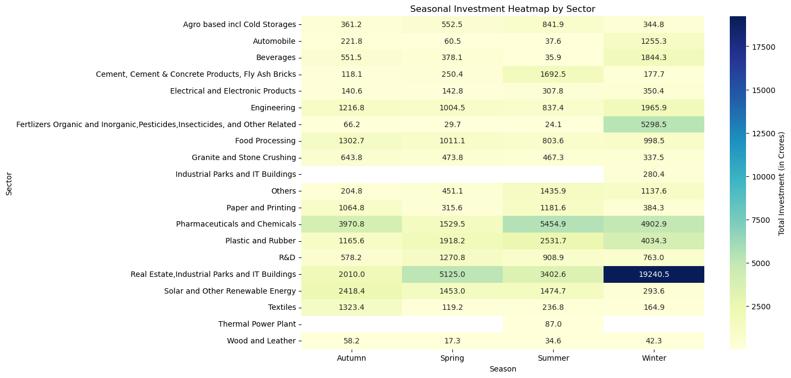
Q-12 "SEASONAL PATTERNS AND CYCLICALITY IN INVESTMENT TRENDS BY SECTOR"
Sectors with Highest Investment in Each Season: season
Autumn : Pharmaceuticals and Chemicals
Spring : Real Estate, Industrial Parks and IT Buildings
Summer : Pharmaceuticals and Chemicals
Winter : Real Estate, Industrial Parks and IT Buildings

Slide 17
Q-12 "MONTHLY INVESTMENT TRENDS BY SECTOR"
Month name sector investment in cr
April Solar and Other Renewable Energy 1202.9360
August Real Estate, Industrial Parks and IT Buildings 2007.6700
December Fertilizers Organic and Inorganic, Pesticides, In... 5274.3477
February Real Estate, Industrial Parks and IT Buildings 17843.3508
January Plastic and Rubber 1803.2376
July Pharmaceuticals and Chemicals 2807.0875
June Pharmaceuticals and Chemicals 1694.0095
March Real Estate, Industrial Parks and IT Buildings 3398.9959
May Real Estate, Industrial Parks and IT Buildings 903.3170
November Solar and Other Renewable Energy 2008.2027
October Pharmaceuticals and Chemicals 930.5270
September Pharmaceuticals and Chemicals 2139.7575
Drilling down into specific months, we can pinpoint key sectors contributing to higher investments:
In February, the Real Estate, Industrial Parks, and IT Buildings sector saw substantial investments.
December witnessed significant investments in Fertilizers, both Organic and Inorganic, Pesticides, and more.
Pharmaceuticals and Chemicals demonstrated strong investment performance in July, June, September, and October.
March showed notable investments in Real Estate, Industrial Parks, and IT Buildings.
Solar and Other Renewable Energy experienced a peak in investment during both April and November.

Slide 18
"TOP 5 DISTRICTS FOR COMMERCIAL PROPERTY INVESTMENT IN TELANGANA"
Rangareddy: Ideal location, infrastructure, and investments in real estate and IT.
2. Medchal Malkajgiri: Growing pharmaceutical sector and proximity to Hyderabad.
3. Hyderabad: Economic hub, IT sector, and urban development.
4. Sangareddy: Investments in pharmaceuticals and plastics, promising growth.
5. Yadadri Bhuvanagiri: Connectivity, infrastructure, and diversified investments.
Factors Supporting Commercial Property Investments:
Strategic location
Strong infrastructure
Diverse economy
Government support
Skilled workforce
These districts offer attractive opportunities for commercial property buyers in Telangana.

Slide 19
Top 5 Insights:
Sector Diversification: Telangana's growth has been driven by a diverse range of sectors, including real estate, pharmaceuticals, IT, and renewable energy. Maintaining this diversification will be key to withstanding economic fluctuations.
Infrastructure Investment: Robust infrastructure, such as improved transportation networks and industrial parks, has been a catalyst for growth. Continued investment in infrastructure will attract more businesses and boost economic development.
Proximity to Hyderabad: Districts in close proximity to Hyderabad, such as Rangareddy and Medchal Malkajgiri, have been investment magnets. Fostering development in these areas can further support economic expansion.
Seasonal Investment Trends: The analysis reveals seasonal investment patterns in specific sectors. Understanding and leveraging these trends can optimize resource allocation and economic planning.
Government Policies: Supportive government policies and initiatives have played a significant role in attracting investments. Maintaining a business-friendly environment will be crucial for sustained growth.

Slide 20
Recommendations:
Promote Skill Development: Invest in skill development programs to nurture a skilled workforce aligned with industry demands. This will enhance the state's attractiveness to investors.
Infrastructure Expansion: Continue infrastructure development, especially in districts with growth potential, to facilitate business operations and connectivity.
Sustainability Focus: Encourage sustainability by incentivizing renewable energy projects and promoting environmentally friendly practices across industries.
Investor Outreach: Proactively reach out to national and international investors, showcasing the state's potential and advantages for investment.
Research and Innovation: Foster a culture of research and innovation by supporting R&D initiatives, technology incubators, and startups to drive future economic growth through innovation-led industries.

Slide 21
Thank you
ramangoyal118@gmail.com
http://www.codebasics.io/

